Slide 1

Operating Systems
Designed by Mr. M Mudassar

Slide 2
Outline
Process
Threads
CPU Scheduling
Process Synchronization
Deadlocks
Memory Management
Virtual Memory
File System
I/O System
Disk Management
Protection
Security

Slide 3
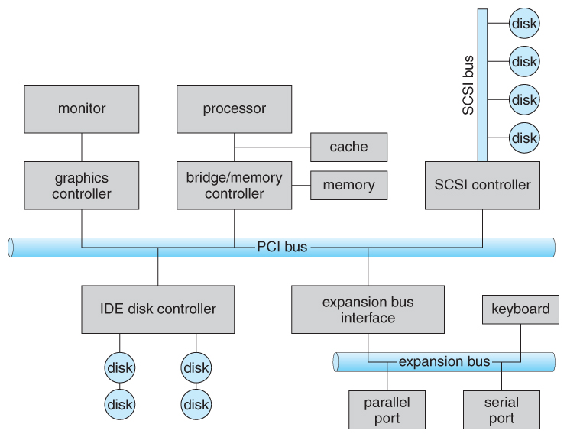
Input Output Management
A typical bus structure.
Character-oriented devices
Block-oriented devices

Slide 4

I/O Kernel Subsystem
Scheduling
I/O request queue for a device
Buffering - storing data in memory while transferring between devices
Device speed mismatch
Device transfer size mismatch
Caching – fast memory holding copy of data
Key to performance
Faster storage of data item that resides elsewhere

Slide 5
I/O Kernel Subsystem
Spooling – Hold out for a device
If device can serve one request at a time
For example, printer
Device Reservation – provides exclusive access to a device
System calls for allocation or deallocation
Watch out for deadlock
Error Handling
OS can recover from disk read/write transient errors
Disk unavailability
System error logs hold problem reports
Dirty block management

Slide 6
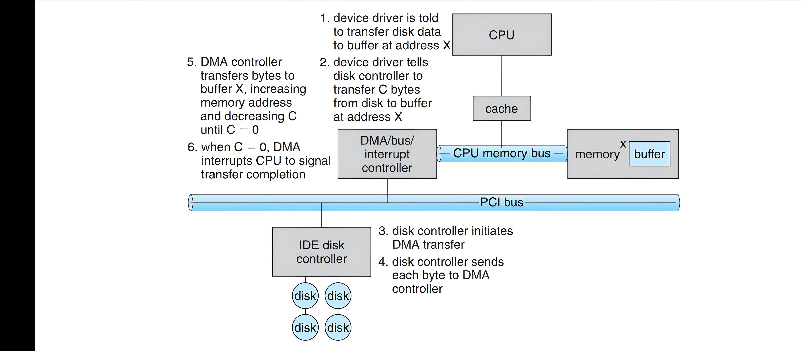
Direct Memory Access (DMA)

Slide 7
Interrupts in Operating Systems
CPU interrupt-request line triggered by I/O device
Interrupt handler receives interrupts
Determines the best course of action
Find out the source of interrupt generation
Analyzes its status
Restart it when appropriate with next operation
Returns control to the interrupted process
Maskable to ignore or delay some interrupts
Interrupt vector to dispatch interrupt to connect handler
Based on priority
Some non-maskable
Interrupt mechanisms are also used for exceptions

Slide 8
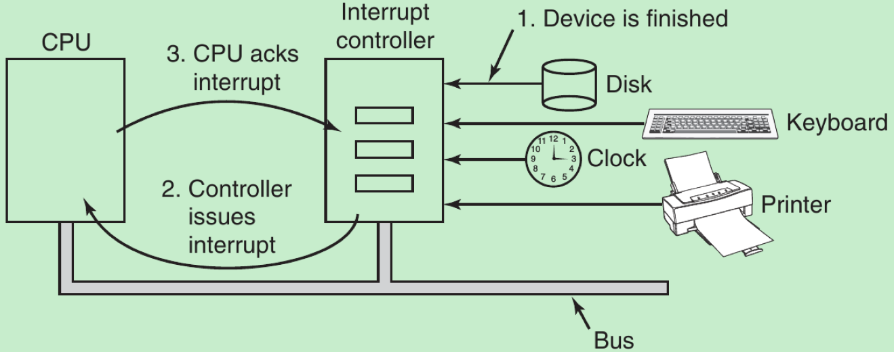
Interrupts in Operating Systems

Slide 9
Interrupts in Operating Systems
Performance overhead
Cost of storing and restoring process states
Cost of flushing the interrupt pipeline
Restoring the instructions into the pipeline when the process is restored

Slide 10
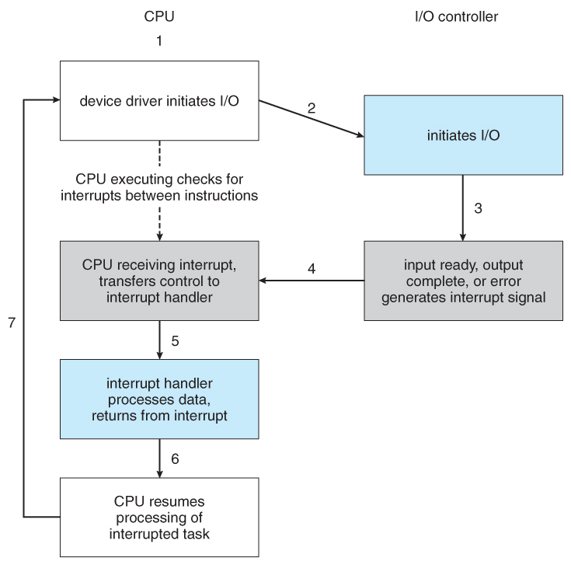
Interrupt Driven I/O Cycle

Slide 11
Thank You(Q & A)

